Slide 1
Analytic Digital Foundation (ADF) Blueprint
June 2019

Slide 2
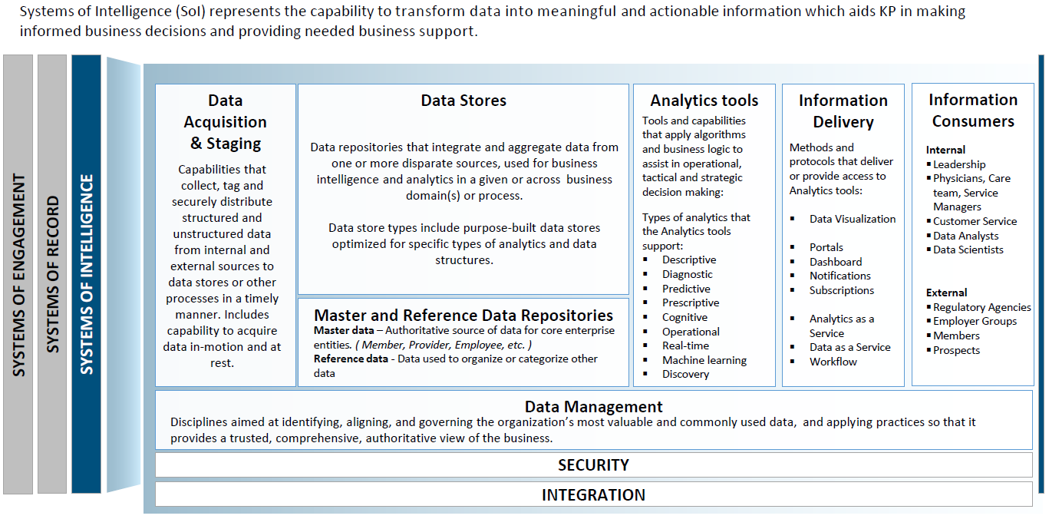
Systems of Intelligence – Level 0 Contextual Architecture
SOI represents the capability to transform data into meaningful and actionable information which aids KP in making informed business decisions and providing needed business support

Slide 3
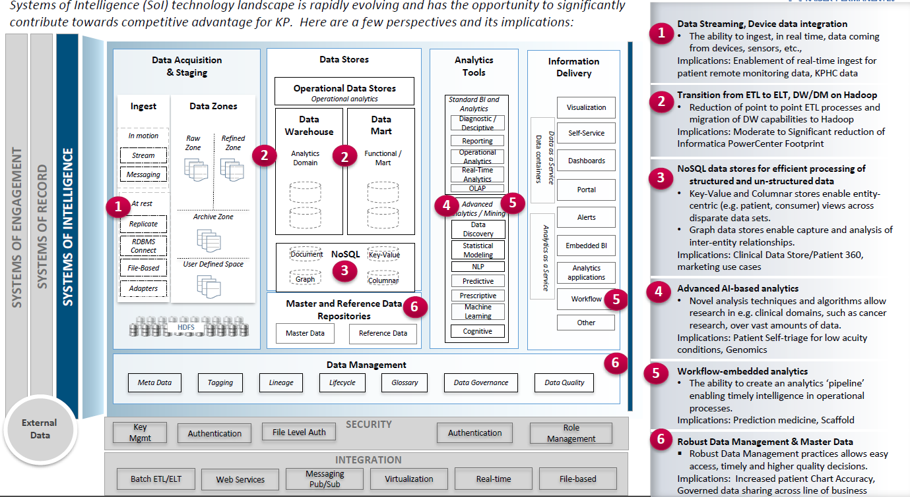
SOI Logical Architecture
SOI technology landscape is rapidly evolving and has the opportunity to significantly contribute towards competitive advantage for KP. Here are a few perspectives and its implications:

Slide 4














ADF Reference Architecture Diagram (As of April 2019)
Microsoft Application Native to MS Azure
Third Party Application Native to MS Azure
Additional technologies to enable Analytics
Hybrid Cloud
Security
Security
SYSTEMS OF ENGAGEMENT
SYSTEMS OF RECORD
SYSTEMS OF INTELLIGENCE
Data Acquisition & Staging
Data Stores
Analytics
Information Access & Delivery
Ingest
Refined
Zone
User
Zone
Data Analytics as a Service
Diagnostic/
Descriptive
Predictive & Prescriptive
Visualization
Portals
In motion
Stream
Reporting
Data Discovery
Power BI
Self-service
Messaging
Power BI
Dashboards
Enriched
Zone
Tenant
Zone
Operational Analytics
Business Intelligence
SQL Server Analysis Services
Advanced Analytics
Raw Zone
Statistical Modelling
Alerts
At rest
Real-Time Analytics
Natural Language Processing
Azure ML Server-R
Azure Machine Learning
Replicate
Archival Zone
LLAP
Analytic as a service APIs
RDBMS connect
Express Routes
Azure SQL DB
TEZ
Online Analytical Processing
Cognitive
Text
Vision
Azure Data Lake Storage
Spark
Business Rules
Cortana
File-Based
Ad-Hoc Analysis
Machine Learning
Recommend
Emotion
HD Insight Hadoop
Azure ML Studio
Bot
Speech
Adapters
Adapters
HDInsight Hbase
Azure Data Lake Storage
Azure Blob
Data Management
Data Management
Metadata
Tagging
Lineage
Data Governance
Data Quality
Master Data Management
Collibra
Waterline Data
Atlas
Collibra
Waterline Data
Tamr
External
Data
Key Mgmt.
Authentication
Authorization
Encryption
Key Vault
SafeNet
Kerberos
Ranger
Azure Encryption
The following slides outline the high level features and key technology catalog for each component of the reference architecture.
:: 4 ::

Slide 5



ADF Reference Architecture – Personas & Toolkits (As of March 2019)
Systems and Data Sourcing Personas
Analytics Community
Personas
Decision-Making
Persona
Note: Data Science Toolkit, while not represented in the architecture below, is under development and will be added upon completion
Platform
Engineer
Data
Engineer
Data Scientist
Data Consultant
Visualization
Expert
Analytics Leader
Decision Maker
Security
SYSTEMS OF ENGAGEMENT
SYSTEMS OF RECORD
SYSTEMS OF INTELLIGENCE
Security
Data Acquisition & Staging (Future Azure Data Factory)
Data Stores
Analytics
Information Access & Delivery
Refined
Zone (Structured - Current SQL DW) - Unstructured future)
User
Zone (Current)
Data Analytics as a Service
In motion
Diagnostic/
Descriptive
Predictive & Prescriptive
Visualization
Portals
Ingest
Stream
Reporting
Data Discovery
Power BI
Self-service
Messaging
Power BI
Dashboards
Enriched
Zone (Structured - Current)
Tenant
Zone (Current)
Operational Analytics
Business Intelligence
Advanced Analytics
SQL Server Analysis Services
Statistical Modelling
Alerts
At rest
Raw Zone (Synapse Future)
Real-Time Analytics
Natural Language Processing
Azure ML Server-R
Azure Machine Learning
Replicate
Archival Zone
LLAP
Analytic as a service APIs
RDBMS connect
Express Routes
Azure SQL DB
TEZ
Online Analytical Processing
Cognitive
Cortana
Text
Vision
Azure Data Lake Storage
Spark
Ad-Hoc Analysis
Business Rules
Machine Learning
Recommend
Emotion
File-Based
Azure Data Factory
HD Insight Hadoop
Azure ML Studio
Adapters
Bot
Speech
Adapters
HDInsight Hbase
Azure Data Lake Storage
Azure Blob
Data
Steward
Data Management
Data Management
Metadata
Tagging
Lineage
Data Governance
Data Quality
Master Data Management
Collibra
Waterline Data
Atlas
Collibra
Waterline Data
Tamr
Key Mgmt.
Authentication
Authorization
Encryption
External
Data
Key Vault
SafeNet
Kerberos
Ranger
Azure Encryption

Slide 6
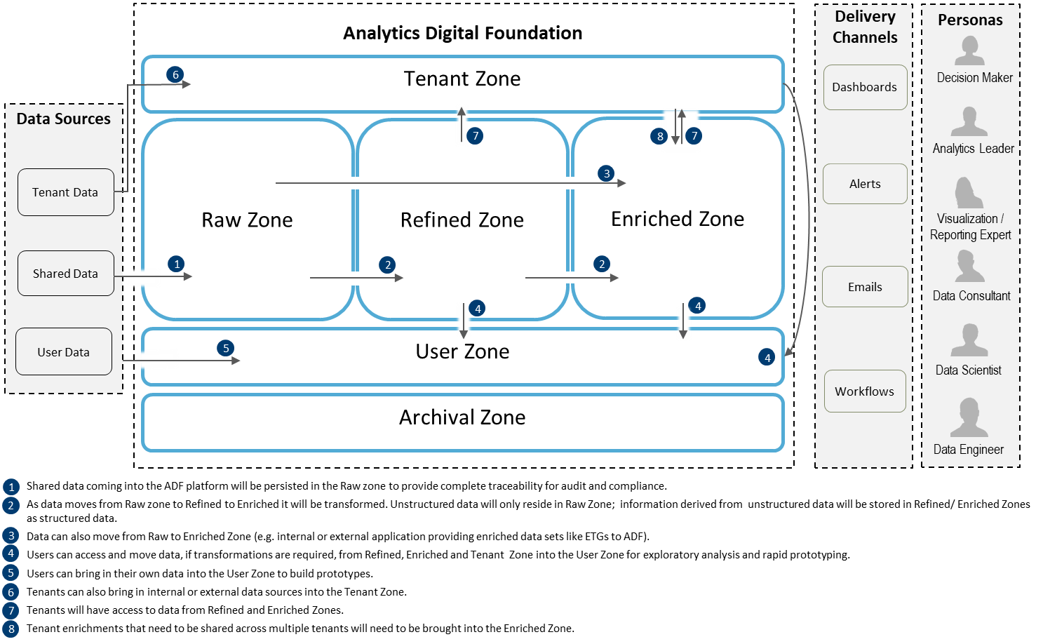
Analytic Digital Foundation: Data Flow Patterns

Slide 7






























Solution Pattern – Overall View (1 of 10)
Standard solution and design patterns have been developed for the architecturally significant use cases for assisting tenant with their specific user cases
Dashboards & Reports
API Gateway *
Events/API
ACS/AKS Kubernetes
Azure API & Web App
Source DBs
Data Science
Modelling *
Express Route (secured connection)
Extract
AAS
Ingest and transform
Tenant Data
Mart/Store
Jupyter, RStudio
Source Data Extracts
Analysis
Stage Server
Common Ingest & Data Processing Framework
(HDInsight Compute Clusters)
Data Engineer Tool
Hive LLAP
Cluster
Alerts & Notifications
GoldenGate
Foundation Data Stores
Hiveserver 2
Refined
User Defined Data Sets
Enriched
DAU Toolkit
Authentication and Data Classification Based Security Policies
(Security Central)
* Work with KP security requirements

Slide 8
Solution Pattern – Tenant Data Mart/Store (2 of 10)
Solution pattern meets tenants need for a separate data mart/store. The data is typically sourced from Refined and Enriched data zones.
Events/API
ACS/AKS Kubernetes
Azure API & Web App
Source DBs
Express Route (secured connection)
Tenant Data
Mart/Store
Extract
Ingest and transform
Analysis
Source Data Extracts
Data Engineer Tool
Stage Server
Common Ingest & Data Processing Framework
(HDInsight Compute Clusters)
Foundation
Data Stores
Hive LLAP
Cluster
Alerts & Notifications
GoldenGate
Hiveserver 2
Enriched
Refined
User Defined Data Sets
DAU Toolkit
Authentication and Data Classification Based Security Policies
(Security Central)

Slide 9
Solution Pattern – Analytical Applications – Streaming & Batch (3 of 10)
Solution pattern enables near-real time dashboards through mobile, web, desktops
Dashboards & Reports
Events/API
ACS/AKS Kubernetes
API Gateway *
Azure API & Web App
Source DBs
Express Route (secured connection)
Extract
AAS
Ingest and transform
Tenant Data
Mart/Store
Source Data Extracts
Stage Server
Common Ingest & Data Processing Framework
(HDInsight Compute Clusters)
Hive LLAP
Cluster
Alerts & Notifications
GoldenGate
Foundation Data Stores
Hiveserver 2
Refined
User Defined Data Sets
Enriched
DAU Toolkit
Authentication and Data Classification Based Security Policies
(Security Central)
* Work with KP security requirements

Slide 10
Solution Pattern – BI and Reporting (4 of 10)
Solution pattern enables standard analytics and reporting capability with tools, such as, Power BI and Azure Analysis Services
Analytics & Extracts
Events/API
ACS/AKS Kubernetes
Azure API & Web App
AAS
Source DBs
Express Route (secured connection)
Tenant Data
Mart/Store
Extract
Ingest and transform
Data Analysis
Source Data Extracts
Data Engineer Tool
Stage Server
Common Ingest & Data Processing Framework
(HDInsight Compute Clusters)
Foundation
Data Stores
Hive LLAP
Cluster
Alerts & Notifications
GoldenGate
Hiveserver 2
Enriched
Refined
User Defined Data Sets
DAU Toolkit
Authentication and Data Classification Based Security Policies
(Security Central)

Slide 11
Solution Pattern – Machine Learning and Data Science Model (5 of 10)
Solution pattern provides for creating and training data science and deep learning models
Events/API
ACS/AKS Kubernetes
DS Model
Repository *
Azure API & Web App
TBD
Tenant Data
Mart/Store
Source DBs
Data Science
Modelling *
Express Route (secured connection)
Extract
Ingest and transform
Jupyter, RStudio
Source Data Extracts
Stage Server
Data Stores
Common Ingest & Data Processing Framework
(HDInsight Compute Clusters)
Enriched
Hive LLAP
Cluster
Alerts & Notifications
GoldenGate
Refined
Hiveserver 2
User Defined Data Sets
DAU Toolkit
Authentication and Data Classification Based Security Policies
(Security Central)
* Tools & Capabilities standards for analytics tool committee is working on defining standards

Slide 12
Solution Pattern: Third Party and/or SoR Data Integration (6 of 10)
Solution pattern provides for data integration between ADF Data Zones and Third Party Applications and/or Systems of Record (SoR)
ACS/AKS Kubernetes
Hive LLAP
Cluster
Azure API & Web App
Tenant Data
Mart/Store
Hive server 2
Data Engineer Tool
SoR/SoI/External Data Sets
Data Extract
Workflows
Express Route (secured connection)
Extract
Ingest and transform
Data Extracts
Source Applications
Stage Server
Data Stores
Common Ingest & Data Processing Framework
(HDInsight Compute Clusters)
Enriched
External Vendor
Alerts & Notifications
External File Transfer
Refined
ADF Framework
Common Data Processing Framework

Slide 13











Solution Pattern (Shared Enrichment Prepared On Premise) (7 of 10)
On Premise
ADF
Data Consumption
(Hive LLAP)
9
Data is available for consumption
Data
Staging
File Watcher picks up the data and sends it to the ADF
Data Ingestion
Framework
Data Delivery
(Enriched Zone)
2
Load
Data Security
Review
ExpressRoute
Publish
Data Ingestion Framework ingests the data
Data is loaded, reviewed, and published in the Enriched Zone
Access control policies are enforced by Ranger
3
5
8
1
Data is prepared on premise, extracted, and placed on the Stage Server
4
All data flowing through the Data Ingestion Framework is automatically tagged
6
Metadata about the shared enrichment is published in the Data Catalog
Data
Tagging
Data
Catalog
Shared Enrichment
Data
7
Tag information is made available to Ranger through Atlas

Slide 14
Solution Pattern (Shared Enrichment Prepared On ADF) (8 of 10)
ADF
Data Engineer (DE) Toolkit
Grouper Software
Data Consumption
(Hive LLAP)
1
Data engineers use the DE Toolkit to prepare shared enrichment from data in the Refined, Enriched, and Tenant Zones
Data may be sent to grouper software
Data is available for consumption
5
Data Preparation and Delivery
(Enriched Zone)
9
Data Ingestion Framework
Data is integrated and transformed by the Data Ingestion Framework
2
Prepare
Load
Data Security
Review
Publish
Data is prepared, loaded, reviewed, and published in the Enriched Zone
Access control policies are enforced by Ranger
4
8
3
All data flowing through the Data Ingestion Framework is automatically tagged
6
Metadata about the shared enrichment is published in the Data Catalog
Refined Zone
Enriched Zone
Data
Tagging
Data
Catalog
Tenant Zone
7
Tag information is made available to Ranger through Atlas

Slide 15
Solution Pattern (Shared Enrichment Prepared On Vendor Site) (9 of 10)
On Premise
ADF
Data Consumption
(Hive LLAP)
Data
Staging
ExpressRoute
10
Data is available for consumption
File Watcher picks up the data and sends it to the ADF
Data Ingestion
Framework
Data Delivery
(Enriched Zone)
3
Project team places data on Stage Server
2
Data Security
Load
Review
Publish
4
Data Ingestion Framework ingests the data
6
Data is loaded, reviewed, and published in the Enriched Zone
Access control policies are enforced by Ranger
9
Vendor Site
1
Shared enrichment data is prepared on vendor site and transferred to KP
5
All data flowing through the Data Ingestion Framework is automatically tagged
7
Metadata about the shared enrichment is published in the Data Catalog
Data
Tagging
Data
Catalog
Vendor
Data
Preparation
8
Tag information is made available to Ranger through Atlas

Slide 16
Solution Pattern (Hybrid) (10 of 10)
Solutions may combine the use of several solution patterns, e.g., enriched data from a vendor that is further transformed on the ADF.
Data Consumption
(Hive LLAP)
On Premise
ADF
Data
Staging
Data Engineer (DE) Toolkit
6
Data engineers use the DE Toolkit to further transform the data
ExpressRoute
11
Data is available for consumption
File Watcher picks up the data and sends it to the ADF
Data Ingestion
Framework
Data Preparation and Delivery
(Enriched Zone)
3
Project team places data on Stage Server
2
Data Security
Prepare
Load
Review
Publish
4
Data Ingestion Framework ingests the data
Data is prepared, loaded, reviewed, and published in the Enriched Zone
Access control policies are enforced by Ranger
7
10
Vendor Site
5
All data flowing through the Data Ingestion Framework is automatically tagged
8
Metadata about the shared enrichment is published in the Data Catalog
1
Vendor transfers enriched data to KP
Data
Tagging
Data
Catalog
Vendor
Data
Preparation
9
Tag information is made available to Ranger through Atlas

Slide 17










Application of ADF Ref. Architecture – Revenue Management Analytics
Acquisition
Source
Ingestion
Staging
Storage
Analytics
Delivery
Data Producer
Platform
Engineer
Data
Engineer
Data Scientist
Data Consultant
Visualization
Expert
Analytics Leader
Decision Maker
Source DBs
Common Ingest & Data Processing
Power BI
Reports, Dashboards, Extracts, etc.
KPHC Clarity – Access, Revenue Cycle, Mgmt. Care Admin; Earhart TPA; SCION; NW Change Healthcare; ePremis; P2P Link – StoneRiver; KP OneLink; Member Month Mart
Raw Zone
1. KPHC Clarity – Access, Revenue Cycle, Mgmt. Care Admin
2. Earhart TPA
3. SCION
4. NW Change Healthcare
5. ePremis
6. P2P Link - StoneRiver
7. KP OneLink
8. Member Month Mart
Refined Zone
1. KPHC Clarity – (Access, Revenue Cycle, Mgmt. Care Admin),
2. Earhart TPA, 3. SCION
4. NW Change Healthcare, 5. ePremis, 6. P2P Link - StoneRiver
7. KP OneLink
SQL Server
Analysis Services
Extract
Tenant
Zone
Revenue Management Analytic Model (RMAM)
Descriptive/
Reporting/
Analytics
(Semantic Layer)
Express Route (secured connection)
Stage Server
Business Rules
Source Data Extracts
Enriched Zone
1. Member Month Mart
2. Revenue Cycle
Financial Class
User
Zone
Data
Steward
Data Management & Security
Systems and Data Sourcing Personas
Analytics Community
Personas
Decision-Making
Persona
Data Intake
Flow
Data Access
Flow

Slide 18
90’s Architecture for Decision Support Systems
Corporate Information Factory
ERP
Accounting
FIN
Finance
Staging
Area
Data
Warehouse
Applications
Data
Marts
CRM
Marketing
ODS
…
Oper
Mart
…
A need to service different user classes requires different types of data repositories:
Data warehouses
Data marts
Operational data stores
Oper marts
Notes:
“A data warehouse is a subject-oriented, integrated, time-variant, and non-volatile collection of data in support of management's decision making process.” - Bill Inmon (1990)

Slide 19
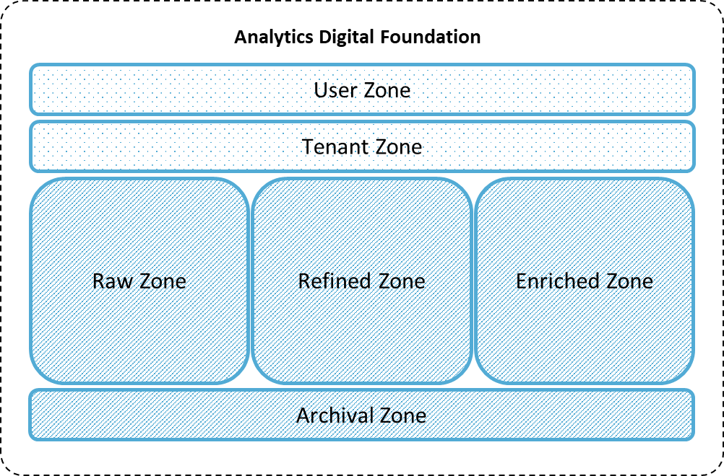

Data Zone Architecture
Zones within the Analytic Digital Foundation (ADF) replace data repositories and embody separation of utilities, support data pipelines, data lifecycle stages, data security, and other data requirements.
Shared Zone
Tenant/User Specific Zone
User access to each zone will be subject to data access use controls

Slide 20






Analytic Digital Foundation: Data Zone Architecture
Data zones will be established to meet varied analytical needs of the tenants and enable reusability of data assets.
Analytic Digital Foundation
Delivery Channels
Personas
Dashboards
User Zone
Decision Maker
Data Sources
Tenant Zone
Alerts
Analytics Leader
User Data
Raw Zone
Refined Zone
Enriched Zone
Visualization / Reporting Expert
Tenant Data
Emails
Data Consultant
Shared Data
Workflows
Data Scientist
Archival Zone
Data Engineer
Shared data is brought into the Raw Zone and propagated to Refined and Enriched Zones
Tenants can bring in data to Tenant Zone to build solutions for their use cases
Individuals can bring in their own data into the User Zone for prototyping/exploratory analysis
Shared Zone
Tenant/User Specific Zone

Slide 21
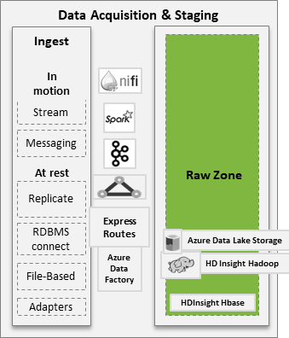
Raw Zone
Definition and Purpose
The Raw Zone is a structure where shared data from data sources first land in the Analytic Digital Foundation for eventual processing into the Refined and Enriched Zones.
The Raw Zone provides a structure where data from enterprise-level data sources can be acquired and stored in its original Raw form once, and used many times to support the data needs of tenants.
Characteristics
Data Characteristics
Volume, variety, and velocity are the dominant characteristics of data stored in the Raw Zone. This zone focuses on rapid ingestion (batch, near real time) of large amounts of a variety of data (structured, semi-structured and unstructured data).
Data Organization
Data is organized by the data source, e.g., KPHC Clarity, OneLink.
Data Refresh
Supports varying latencies of data integration, from daily batches to continuous real-time integration, and are scalable to support more aggressive data freshness based on the needs of the maturing organization.

Slide 22
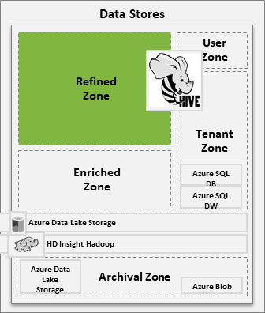
Refined Zone
Definition and Purpose
The Refined Zone is a structure designed to store and deliver shared data that has been prepared for the use of all tenants.
The Refined Zone provides a structure where data preparations needed by all tenants can be performed and stored once, and used many times.
Characteristics
Data Characteristics
Volume is the dominant characteristic of data in the Refined Zone as all historical records are maintained. Velocity varies based on business goals to support the multiple data freshness service levels.
Data Organization
Data is organized by information data domains which logically group data based on functional categories of the business, e.g., claims, membership, care delivery.
Data Refresh
Supports different service levels for data freshness driven by business goals. Time stamping and view constructs are used to support the multiple data freshness service levels.

Slide 23
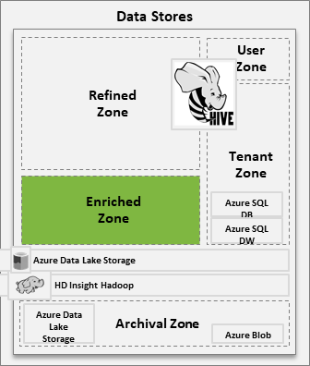
Enriched Zone
Definition and Purpose
The Enriched Zone is a structure designed to store and deliver newly derived shared data, generated by manipulating and blending data from the Raw and Refined Zones, for the use of all tenants.
The Enriched Zone provides a structure where common enrichments can be developed and stored once, and used many times. Sharing common enrichments improves the consistency of information produced across the tenants.
Characteristics
Data Characteristics
Veracity is the dominant characteristic of data in the Enriched Zone as it is needed to store high quality data for strategic decision making.
Data Organization
Data is organized by the category of enrichment, e.g., costed utilization (includes care delivery, health plan, medical group, IBNR, etc.), member month (includes product line, line of business, service area primary, member lookup, etc.).
Data Refresh
Supports mostly long-term decision making where the stability of the data needs to match the grain of analysis. Calendar rollups (day, week, month, quarter, and year) are used instead of servicing each grain with its own set of tables.

Slide 24
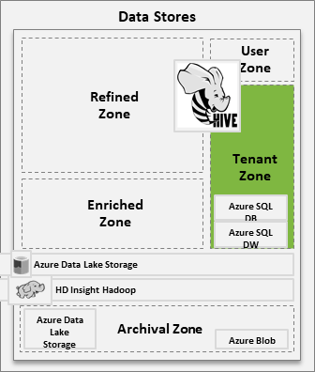
Tenant Zone
Definition and Purpose
The Tenant Zone is a structure designed to store and deliver data produced by tenants for their users to consume.
The Tenant Zone provides a structure that is optimized for the delivery of analytics solutions while the Raw and Refined Zones are optimized for the acquisition and preparation of data for reuse (separation of concerns).
Characteristics
Data Characteristics
Generally veracity is the dominant characteristic of data in the Tenant Zone as different types of data that is required for use cases of specific tenant. However, volume, variety, and velocity are dependent on Tenant use cases. In order to make data accessible to users, data is predominantly stored using pre-defined format / schemas (schema-on-write approach). However, tenant specific data from external sources can also be stored using schema-on-read approach.
Data Organization
Data is organized by the tenant domain, e.g., profitability reporting and cost, revenue management analytics, sales and marketing analytics.
Data Refresh
Data freshness is driven by the tenant goals.

Slide 25
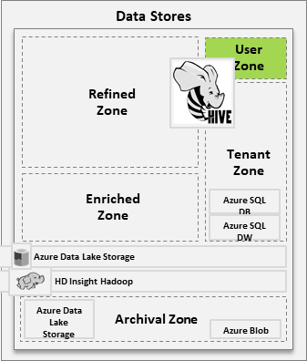
User Zone
Definition and Purpose
The User Zone is a structure where advanced users (e.g., data scientists) can introduce their own data needed to perform exploratory data science and analysis.
Successful data science efforts can be operationalized to use the Raw, Refined, and Enriched Zones for broader consumption by tenants.
Characteristics
Data Characteristics
Variety is the dominant characteristic of the User Zone as it allows qualified users to bring in different types of data, either from Refined, Enriched, Tenant, or user specific data, for the purpose of exploratory analysis.
Data Organization
Data organization is highly personalized and based on an individual's use case requirements.
Data Refresh
Data freshness is driven by the user goals.

Slide 26
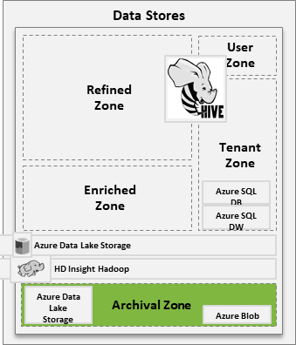
Archival Zone
Definition and Purpose
The Archival zone is a structure designed to store Tenant required historical and inactive data from the Refined, Enriched, and Tenant Zones for long-term Archival.
The Archival Zone provides a structure for cost-effective long-term storage of data that is no longer actively needed for everyday operations but remains important for future reference or regulatory compliance.
Characteristics
Data Characteristics
Volume is the dominant characteristic of data in the Archival Zone as it stores structured data from Refined, Enriched, and Tenant Zone for an extended period of time for the purpose of audit and compliance. Retired data assets that are part of the initial migration to the platform are also archived, if needed.
Data Organization
Data is organized based on the origination data zone, e.g., Refined Zone, Enriched Zone, Tenant Zone.
Data Refresh
Data will be loaded into the Archival Zone based on specific data retention polices established by the tenants and the foundation data teams.

Slide 27
Foundation Data - Reference Implementation

Slide 28
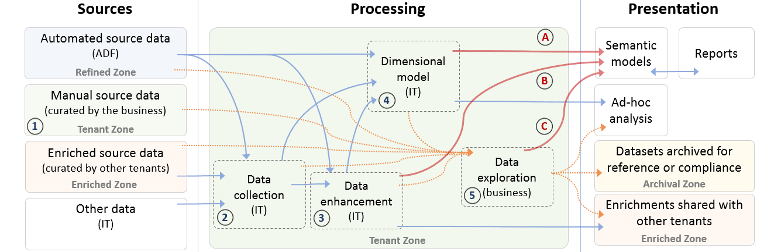
Reference Implementation Overview
A full stack deployment that demonstrates multiple capabilities of the ADF to deliver information and enrichments through a fully developed tenancy.
Sources
Tenancy
Clarity*N, fully validated and complete
Non-programmatic data sources (goals, for example)
Tenant specific data from programmatic sources
Data collection – Staging schema for data not sourced from the refined zone, or requiring pre-processing for use
Data enhancement – IT supported schema containing complex custom routines that produce ‘source of truth’ reference data or metrics for consumption by the tenant or publication to the Enriched Zone
Dimensional model – Star schema underpins the OLAP semantic model for self serve reporting and analysis
Data exploration – Tenant analysts develop ad-hocs and perform research for business partners
Five Tenant Schemas: (1) Curation, (2) Collection, (3) Enhancement, (4) Dimensional Model, (5) Exploration

Slide 29
Change Data Capture – Feature Overview
Change Data Capture (CDC) is the process of detecting changes in source data and ensuring that the target tables are appropriately updated, added to, or modified to preserve an accurate reflection of that source.
Standard CDC
Insert
Update
Change Data Capture
CDC when no unique key is present
Pre-Processing
and/or
Post-Processing
Delete
Non-Standard CDC
CDC when unique key is updated
Mass data purges in source
Standard Change Data Capture
Non-Standard Change Data Capture
Identify net new data from source and insert in ADF
Detect updates from source and apply to existing ADF data
Identify deletes in source and logically delete in ADF
Handle changes to keys in source and implicit deletes
Ingest entities with no unique keys
Detect mass data purges/updates that occur in the source
Notes:
Non-standard CDC examples:
CDC: How do we recognize and process new data and changes to existing data in a programtic way
All CDC will be type 2 = updates to data include maintaining a copy of as-is data, SOR and Epic are not always designed to accommodate this, what did the data look like at a point in time, required for regulatory reporting
Examples: Fee schedule, ePIMS and PDW
No data is physically deleted
POC will test this

Slide 30
Clarity*N – Feature Overview
Clarity*N is a single view of Clarity that sources data from regional Clarity instances and addresses version skew. This combined view of regional data can be consumed by regional and program level tenants for reporting and analytics.
Difference in Epic Clarity versions
Clarity*N
Regional Variances
Different business modules in regions
Data deprecations
Schema Evolution
Tenant/Region-specific
tables
Schema Design
Data Model Design
Address Regional Variances
Address Schema Evolution
Option1: Physical Schema
Option 2: Logical Schema
Option 1: Standard Epic Clarity Data Model Definition with Data Type Transformations
Option 2: Superset of Regional Clarity Structures
Difference in Tables Across Regions
Difference in Columns Across Regions
Difference in Data Types Across Regions
Schema Evolution for Physical or Logical Schema of Clarity*N
Impact of schema evolution on Clarity*N

Slide 31

Clarity*N – Data Flow Design
Clarity*N receives data from source HCCLXX schemas. This data flows into ADF via the Raw Zone before being loaded into the Refined Zone of ADF. Data from regional instances is present in ADF Regional Clarity in their native form. Clarity*N is created by combining the regional data from ADF Regional Clarity.
Clarity Compass
HCCLXX
Clarity-ADF
Source
Clarity Files
Staging
Raw Zone
ADF Regional Clarity
Clarity*N
Legend
Data Flow
Refined Zone
Tenant Zone
Foundation manages the technical variation; Tenants manage content harmonization.

Slide 32
Clarity*N – Technical Variation Metrics
Technical variations exist across regional instances of Clarity due to differences in Epic versions, different workflow needs, and regional customizations to meet region specific or program needs.
Clarity *N – Regional Clarity Variation Analysis metrics

Slide 33

Clarity*N – Solution Design
Recommendation
Logical Schema (View)
Standard Epic Clarity Data Model
A logical schema with views that collate and transform the data from the ADF Regional Clarity instances in ADF.
Views are defined to logically combine and transform the data from ADF Regional Clarity instances. There is no redundancy of data in Clarity*N.
Adopt standard Epic Clarity data definitions from the latest Clarity implemented across all regional source systems.
All standard Epic entities will be present in Clarity*N.
Tenant or region-specific entities (e.g. X_* tables) will not be in Clarity*N.
Advantages
No data replication and redundancy between ADF Regional Clarity and Clarity*N.
No data model management is required to manage table and attribute definitions, datatypes, constraints, and referential integrity.
When source schema changes, only the views need to be maintained. There is one less hop to be maintained in the ADF pipeline.
High availability of data - as soon as data is available in ADF Regional Clarity, the views will reflect the latest data automatically. There is no ETL required.
Accelerated adoption of Clarity*N data model due availability of the standard Epic data definition.
Maintenance of Clarity*N is simple as standard Epic data definitions are adopted.
When source schema changes, Clarity*N will only address data compatibility^ to ensure there is no data truncation.
Low latency when source schema changes, as only data type transformations are addressed.
If the user requires data from multiple regions, then the standard epic schema is easier to consume.
Future Decision: Upon completion of the Proof of Concept to confirm feasibility and operationalization of the Solution Design recommendation, results will be presented and approval will be requested of the Steering Committee for adoption of design.

Slide 34
Data Content and Validation – Feature Overview
Data Content addresses the types of Clarity data structures that must be stored in Clarity*N. Data Validation is the processes to perform balancing of data during data load as well as reconciliation post data load to ensure parity between the regional Clarity source data and Clarity*N data.
Epic extracted tables
Data Content
Table Types
Epic views
Data Content and Validation
Derived tables
Pre-validation
Data Validation
Data Pipeline Balancing
Data Reconciliation
Data Content
Data Validation
Clarity*N must support the following data structures from HCCLXX schemas which is dependent on Clarity*N design options:
Epic extracted tables
Epic views
Derived tables
Tenant or region-specific tables
Clarity*N must have validation processes to check for accuracy and completeness of data.
Data validation occurs in three stages:
Pre-validation
Data Pipeline Balancing
Data Reconciliation

Slide 35
Data Validation – Approach Overview
Data Validation in Clarity-ADF is divided into the below 3 categories:
Pre-validation of data when data is loaded from the source Clarity files into the staging layer of ADF.
Data pipeline balancing that occurs across the Clarity-ADF pipeline.
Data reconciliation to verify parity of data between source and Clarity-ADF.
HCCLXX
Clarity Compass
Source Clarity Files
Clarity-ADF
Staging
Clarity-ADF
ADF Regional Clarity
Clarity*N
Raw Zone
Refined Zone
Legend
Data Flow
Data Pipeline Balancing
Data Reconciliation

Slide 36
Data Validation – Proposed Approach
Purpose
The purpose of data validation is to ensure:
Completeness of data load.
Accuracy of data in Clarity-ADF
Parity between source Clarity data and Clarity-ADF
Approach
Pre-validation
Data Pipeline Balancing
Data Reconciliation
Pre-validation of data occurs on the source Clarity files that are received from the regional source Clarity systems - HCCLXX schemas.
In this stage, the following checks are performed:
Source file eligibility check
Total counts
Identification of full/delta loads
Threshold calculation and checks
Error logging and balancing will be performed across the data pipeline from HCCLXX to Clarity*N.
Errors or warning identified at every stage will be logged in a centralized repository.
These logs will be made available via subscription-based reports.
Remediation of exceptions and errors must be performed to account for all the records in the final parity check.
Data reconciliation will be performed between ADF Regional Clarity and source Clarity HCCLXX to ensure accuracy of data.
Data validation will be performed against the source for Clarity*N data accounting for schema changes.
Some methods to perform data reconciliation include:
Counts
Checksums
Minus Queries
Distribution Queries
Future Decision: Upon completion of the Proof of Concept to confirm feasibility and operationalization of the Solution Design recommendation, results will be presented and approval will be requested of the Steering Committee for adoption of design.

Slide 37
Foundation Data - Data Ingest

